Slide 1
Week 9: Comparing means from unrelated samples
PSYC121: Statistics for Psychologists
Dr Tom Beesley
t.beesley@lancaster.ac.uk

Slide 2

Revision of some concepts
The t distribution
The t statistic:
The mean of our sample
The expected mean under the null hypothesis
$$t=\frac{\overline{x}−μ}{SE}$$
Estimate of the variance in the means of samples
The bigger the difference between what is expected under the null and what we observe, the bigger the value of t we will observe
The smaller the variance in the data (SE), the bigger the value of t.

Slide 3
Related samples
These designs can be very powerful in a lot of situations.
Hypothesis: vehicle stopping times (seconds to stop at 60mph) are slower in the evening than the morning.
Related samples
Unrelated samples (next week)
 | 9AM | 9PM
P1 | 5.3 | 6.1
P2 | 4.3 | 4.6
P3 | 4.9 | 4.3
P4 | 5.2 | 6.7
P5 | 8.3 | 9.9
P6 | 3.0 | 4.1
P7 | 4.7 | 5.2
P8 | 5.1 | 6.0
 | 9AM
P1 | 5.3
P2 | 4.3
P3 | 4.9
P4 | 5.2
P5 | 8.3
P6 | 3.0
P7 | 4.7
P8 | 5.1
 | 9PM
P9 | 6.0
P10 | 9.9
P11 | 4.6
P12 | 4.1
P13 | 4.3
P14 | 5.2
P15 | 6.7
P16 | 6.1

Slide 4
Related samples designs
An experimenter wants to test if people’s ability to rub their tummy while patting their head depends on their amount of sleep. He wants to test people after 3 hours and 8 hours sleep.
Sleep study problems
People get better at the task with practice
Order effects to 3 vs. 8 hours?
Counterbalancing is an option

Slide 5
Related samples designs
An experimenter wants to examine mood induction on the feeling of warmth towards others. After making people happy or sad, the experimenter has the participants engage in a team-building exercise. People rate others in the group for how warm their interactions were.
Social warmth study problems
Once people know they will rate for warmth, this will probably affect their behaviour
We could have ratings made after all testing complete
But one mood induction might affect the other.
Difficult to run as within-subjects (related samples)
Might work well as between-subjects (group split into happy/sad)

Slide 6
Related samples designs
An experimenter wants to test perception of subliminal meaning in records. She has participants listen to either a 3 minute pop song or heavy metal song and then asks them a structured series of questions to see if they picked up on the message.
Subliminal perception study problems
Once participants are made aware of subliminal message, they will almost certainly look for it.
Sometimes it’s impossible to use a within-subjects design.

Slide 7
Unrelated samples
Often we want to purposefully compare different groups of people:
Male vs. Female
Young vs. Old
English vs. Australian
Patient population vs. control

Slide 8
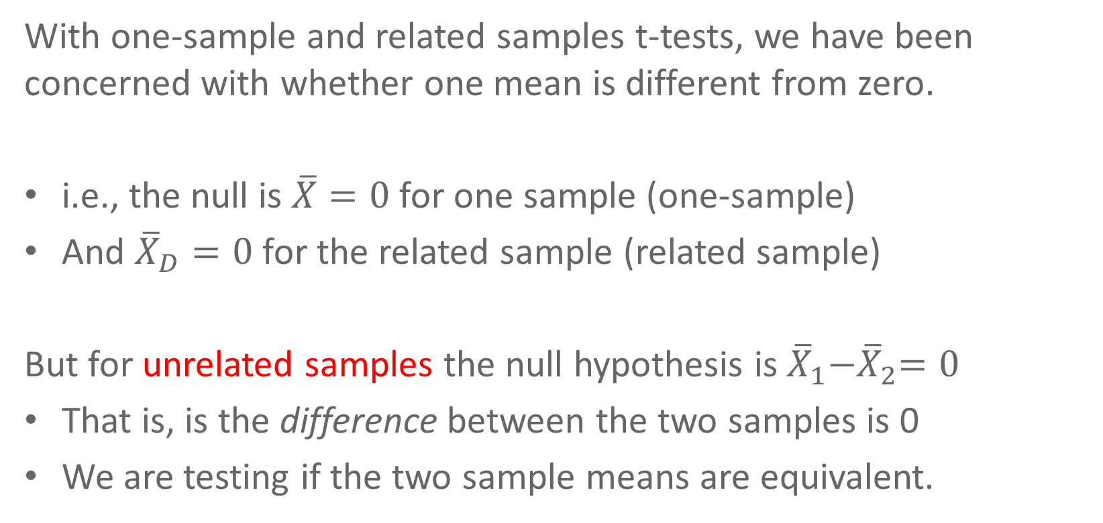
Unrelated samples
With one-sample and related samples t-tests, we have been concerned with whether one mean is different from zero.
i.e., the null is $\overline{X}=0$ for one sample (one-sample)
And ${\overline{X}}_{D}=0$ for the related sample (related sample)
But for unrelated samples the null hypothesis is ${\overline{X}}_{1}{−\overline{X}}_{2}=0$
That is, is the difference between the two samples is 0
We are testing if the two sample means are equivalent.

Slide 9
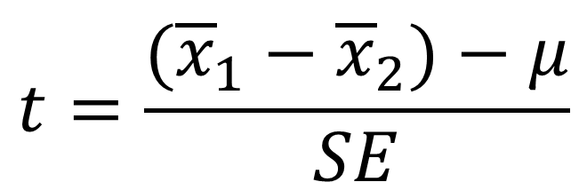
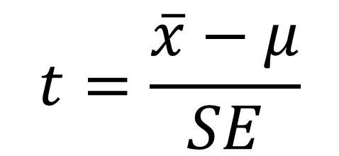
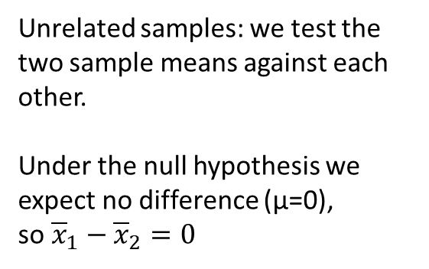
Unrelated samples t-test
The logic of the t-test is very similar
$$t=\frac{\overline{x}−μ}{SE}$$
$$t=\frac{({\overline{x}}_{1}−{\overline{x}}_{2})−μ}{SE}$$
One sample: we test the sample mean against an expected value.
Related samples: we test the mean of difference scores against the expected value (μ = 0)
Unrelated samples: we test the two sample means against each other.
Under the null hypothesis we expect no difference (μ=0), so${\overline{x}}_{1}−{\overline{x}}_{2}=0$

Slide 10
Unrelated samples t-test
When we are comparing different sample means, the data come from samples with independent variances.
That is, two variances need to be combined.
We call this, “pooling of variances”
This is where it gets more complex, since we need to use information about each variance.
And frequently the variances need to be weighted according to the size of each sample.

Slide 11
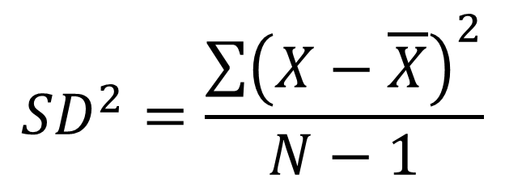
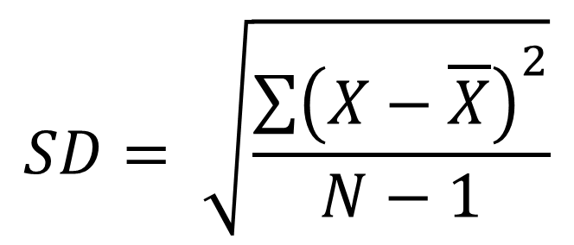
Measures of variability (recap)
$$SD= \sqrt{\frac{\sum{{\left(X−\overline{X}\right)}^{2}}}{N−1}}$$
Standard deviation
$${SD}^{2}=\frac{\sum{{\left(X−\overline{X}\right)}^{2}}}{N−1}$$
Variance

Slide 12
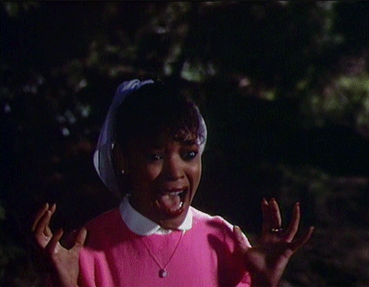
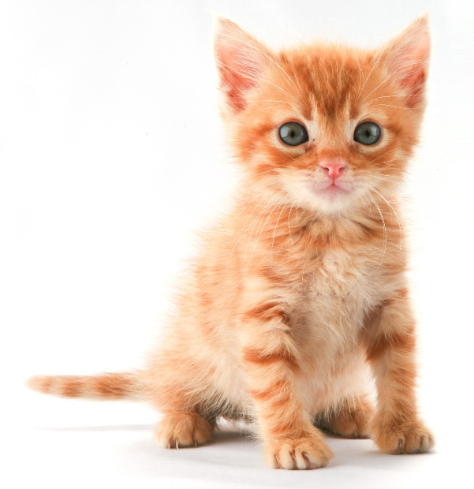
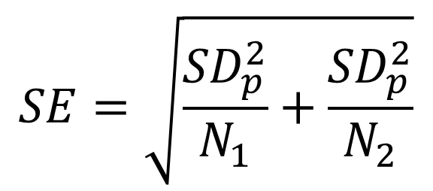
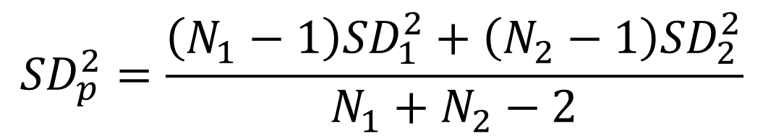
Pooled variance
$${SD}_{p}^{2}=\frac{\left(N_{1}−1\right){SD}_{1}^{2}+\left(N_{2}−1\right){SD}_{2}^{2}}{N_{1}+N_{2}−2}$$
$$SE=\sqrt{\frac{{SD}_{p}^{2}}{N_{1}}+\frac{{SD}_{p}^{2}}{N_{2}}}$$

Slide 13
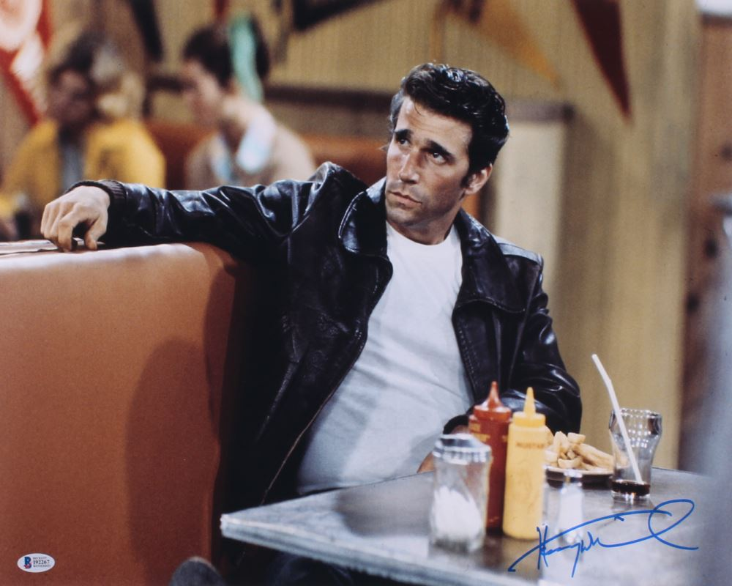
Pooled variance
I just looked at the kitten…
That’s OK, it was mainly for my benefit
Just know this – when we take data from independent samples, we need to compute SE differently
“Differently” means we take into account the variance of each sample.

Slide 14
Homogeneity of variance
One of the assumptions of the unrelated samples t-test is that variances of the samples are equivalent (homogeneity of variance).
We should check this before running our t-test
This is easy to do in RStudio with the var.test() function.
If this produces a p < .05, then variances are not homogenous
This affects how we run our t-test, and we’ll practice this in the lab.

Slide 15
Degrees of freedom
We are estimating two means (from independent samples)
So our df has to reflect this independence in the data
Df = (N₁ - 1) + (N₂ - 1) = N₁ + N₂ – 2

Slide 16
Power
We’ve talked about Type 1 errors:
- when we reject the null hypothesis when it is true
- We set our α (alpha) level at 0.05.
- Reduces Type 1 errors to an acceptable rate.
But what about Type 2 errors?
- when we fail to reject the null hypothesis when it is false
- our experiment fails to prove a real effect
- how do we avoid these failures?

Slide 17
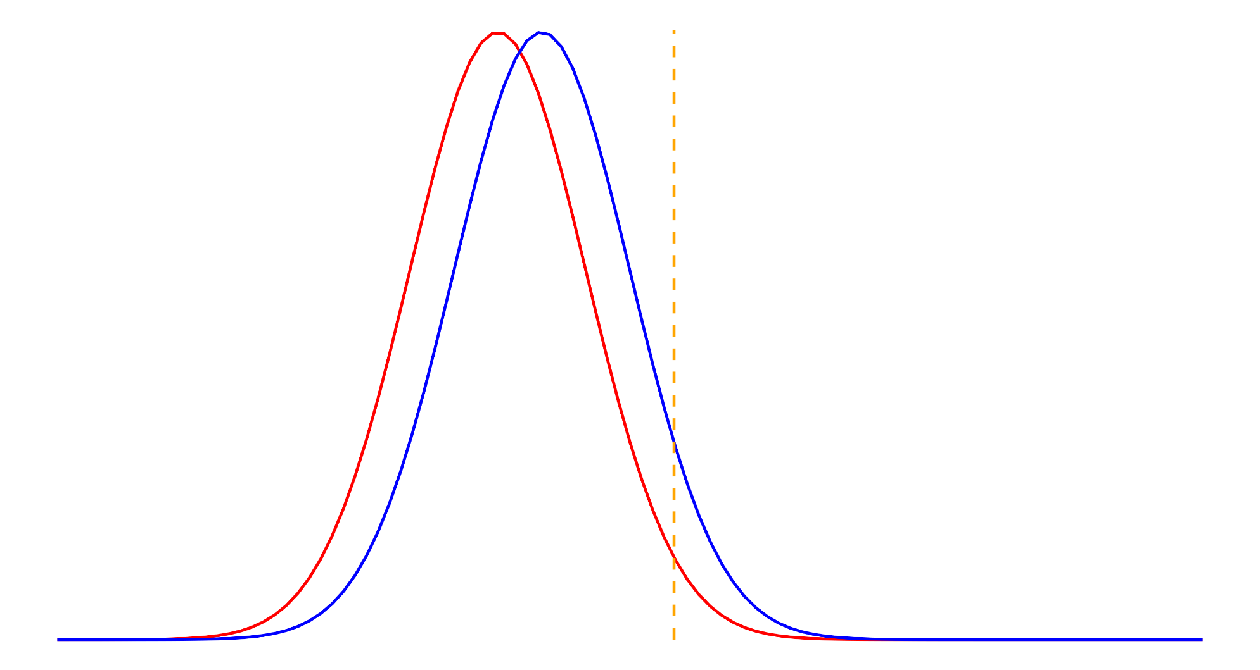
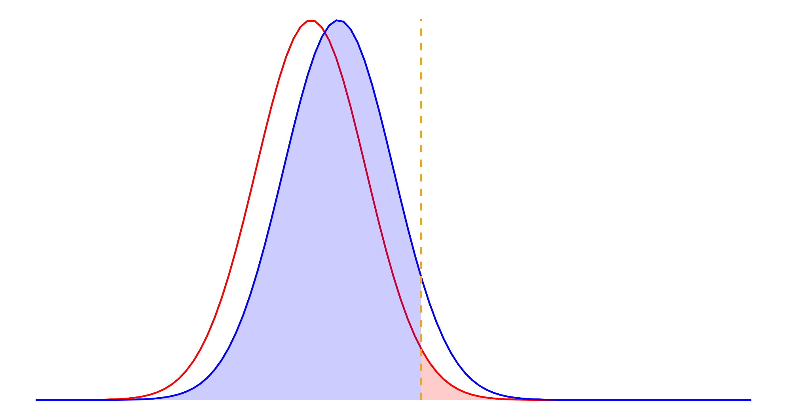
Power
α = Type 1 error
β = Type 2 error
β
α

Slide 18
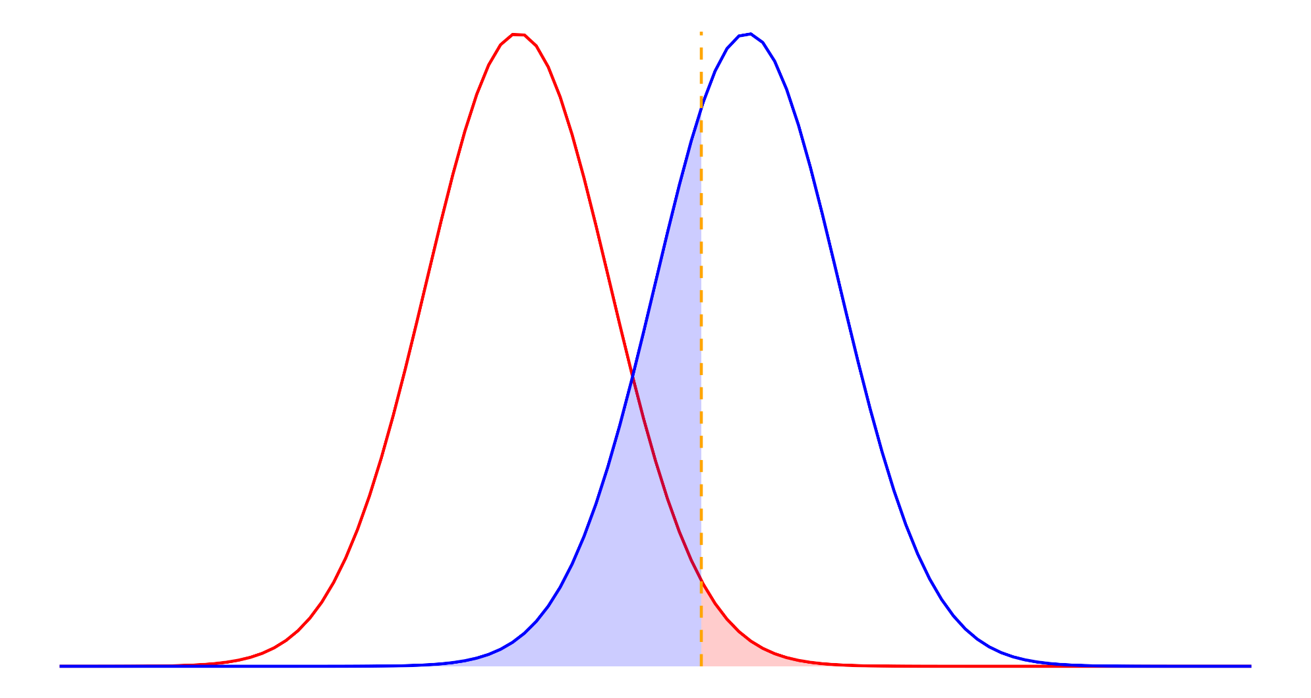
Power
α = Type 1 error
β = Type 2 error
α
β

Slide 19
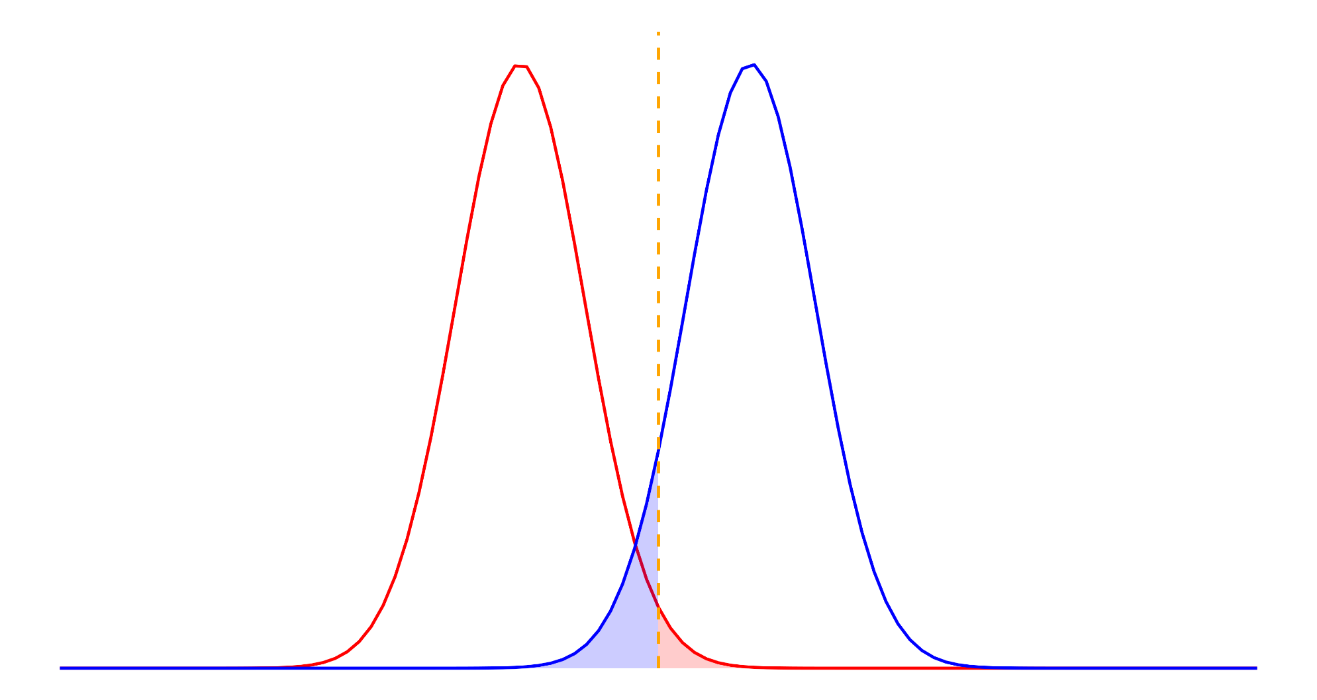
Power
α = Type 1 error
β = Type 2 error
β
α

Slide 20

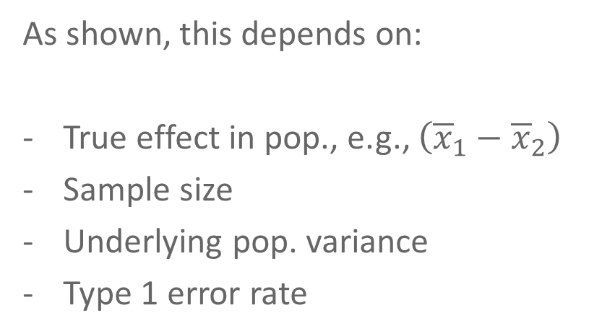
Power
As shown, this depends on:
True effect in pop., e.g., $\left({\overline{x}}_{1}−{\overline{x}}_{2}\right)$
Sample size
Underlying pop. variance
Type 1 error rate
Power is defined as 1 – β
Reflects how likely an experiment is to find a real effect if one exists
β

Slide 21


Achieving appropriate power
Cohen’s d
Standardised measurement of effect size
“What sample size do I need?”
To answer this, we need to know what size of effect we are looking for.
Well what about t? – use that?
As N increases, t increases.
$$d=\frac{\overline{x}−μ}{SD}$$
$$t=\frac{\overline{x}−μ}{SE}$$

Slide 22
Achieving appropriate power
Cohen’s d
Standardised measurement of effect size
“What sample size do I need?”
We can look at effect size from previous studies
Or, we estimate it, based on convention:
small: d = .2
medium: d = .5
large: d = .8
$$d=\frac{\overline{x}−μ}{SD}$$

Slide 23
Estimating sample size
pwr.t.test(power = .8, d = .5)
N = 63.8
pwr.t.test(N = 100, d = .5)
Power = 0.94 (94%)
pwr.t.test(power = .8, N = 50)
d = 0.57
SAMPLE SIZE
POWER
EFFECT SIZE

Slide 24
Summary
t-tests for unrelated (independent) samples examine differences between two sample means.
The null hypothesis is that no difference exists
Standard error is computed by using a pooled variance term, which takes into account the variances and sample sizes of each sample
Power: our experiments need to be sufficiently “powered” to detect real effects that exist.
If they are not, then we’ll frequently commit type 2 errors
We can estimate power from effect size and the sample size (N) we plan to use
Similarly, we can estimate the required N, or the effect size we might detect.

